Slide 1
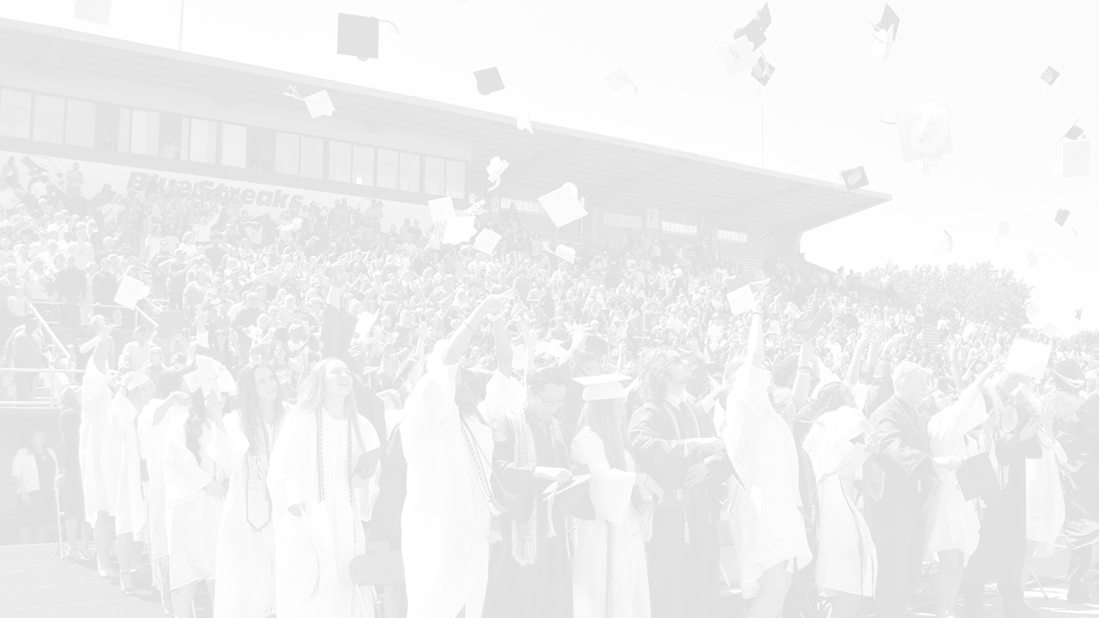
Envision 2030 Building Capacity and Strengthening Innovation
Mid-Year Update
April 8, 2022

Slide 2
Fundamental Core Principles
To affirm, every SCS student has access to an unparalleled school experience.
To maintain a grade of ‘C’ or higher on the ODE Report Card.
To embrace and operate organizationally with a Transformational mindset.
To evaluate what elements of a program or initiative should be A) maintained in current form, B) modified, or C) significantly changed.
To ensure all SCS innovative programs are relevant, competitive, cutting edge, and worthy of continuation.
To determine if results justify the time, labor, and fiscal investment required to continue the program.

Slide 3
Innovative Programs: Envision 2030: Building Capacity & Strengthening Innovation
Blue Streak University
The Sandusky Career Center
The Global Internship Experience
The Sandusky Digital Learning Center
The Career Tech Education Program
The Regional Center for Arts & Academic Studies
The Food Service and Nutrition Program
The Great Lakes Visual and Performing Arts Academy

Slide 4
Measure Progress

Slide 5
BLUE STREAK UNIVERSITY: Dr. Richard Koonce
Goal: Increase CCP participation among under represented student populations to 10% of overall group enrollment.
African American Multi-Racial Hispanic
Current: 6.42% Current: 7.27% Current: 8.89%
Goal: Increase number of students earning Associate Degrees:
2018-19 2019-20 2020-21 2021-22
1 5 3 6
Goal: Increase the number of credits earned:
1,032 attempted – Projected: credits earned highest in 3 years
85% of credits attempted result in credits earned

Slide 6
GLOBAL INTERNSHIP EXPERIENCE Mrs. Brandy Bennett
Goal: Increase number of paid internships by 200%
GIE has increased paid internships by 125% (15 students)
Goal: Increase senior year-long internships by 500%
GIE has increased senior year-long internships by 425% (17 students)
Notable Internship Experiences:
Cleveland Cavaliers
Cleveland Zoo
Lewco
Federal Bureau of Investigation
Lucas County Coroner’s Office
Lt. Governor Husted and U.S. Rep Kaptur

Slide 7
REGIONAL CENTER FOR ARTS & ACADEMIC STUDIES: Mrs. Tara Toft
Goal: Increase Gifted Services across the district
RCAAS: added gifted arts services
SMS: added gifted arts services through the GLVPAA
SHS: added gifted arts services through the GLVPAA
Goal: Increase Open Enrollment participation in Gifted Programs across the district
1st and 2nd grades: 7% of Open Enrolled students are identified as gifted
3rd through 6th grades: 47% of Open Enrolled students are identified as gifted
7th and 8th grades: 24% of Open Enrolled students are identified as gifted
9th through 12th grades: 21% of Open Enrolled students are identified as gifted

Slide 8
SANDUSKY CAREER CENTER: Mrs. Rebecca Romano
Goal: Re-brand Sandusky Career Center and re-locate to stand alone facility
Successful relocation to the former Venice School site
Goal: Create an Enrollment and Assessment Coordinator position
Career advising and provide supports for students in jeopardy of not completing
Goal: Enhance current programming and introduce new adult learner opportunities
Redesign: Medical Assisting to Patient Care
Re-introduction: Advanced cosmetology
New program: Barber College

Slide 9
SANDUSKY DIGITAL LEARNING CENTER Mrs. Sherry Smith
Goal: Introduce a strategy to link at-risk students and families to community resources to improve attendance and provide internship opportunities
Initiated Project Succeed – attendance incentive
Initiated Senior Symposium
Attendance improved by 20%
Implemented food pantry
Goal: Create and implement programming and services for adolescent and middle school students
Enrollment grades K-6: approximately 100 students
Services provided: mental health; intervention specialists; Firelands Forward; Project Succeed (transit and taxi passes)
Project Rise-Up – industry recognized credential – graduation pathway

Slide 10
ADDITIONAL INFORMATION & QUESTIONS
For additional information regarding Envision 2030, please visit
www.scs-k12.net/Transformation.aspx
or contact
Mr. Dennis Muratori
Chief of Staff and Transformation Officer
dmuratori@scs-k12.net
419-984-1016

